Slide 1

Can we predict the S&P returns?
Springboard – Data Science Career Track
marcelo Fuentes
January 2020

Slide 2
Problem & Context
The S&P index is used as an investment vehicle and investment performance benchmark by institutional and large private investors alike, thus being able to forecast its returns with high accuracy is of utmost importance for both of these groups.
This project uses different statistical models and variables in order to find the best forecast of the S&P closing price with the smallest Mean Absolute Deviations and Mean Absolute Percentage Error

Slide 3

Stakeholders
Some of the key stakeholders for this project would be Asset Management Firms, Pension Funds, Endowments and Market Risk Managers
Any sort of organization which uses the S&P index as a performance benchmark would find this project to be meaningful.

Slide 4
Success Metrics & Constrains
The success metrics for this project would be to find an estimator able to provide a forecast with less than 1% Mean Absolute Percentage Error, since any error above this percentage would deem the forecast to be useless or too inaccurate to be useful for a stakeholder. Four different models were tested Auto Regressive Integrated Moving Average (ARIMA), Vector Autoregression (VAR), Ridge Regression and a Recursive Neural Network (RNN).
The constrains of this analysis are that the data we were able to source only includes stock market opening, closing, minimum, maximum and daily traded volumes. However, we do not have any information regarding the price fluctuations the S&P index or any its constituents underwent on any given day, therefore this forecast would only allow for daily and not intra-day trading.

Slide 5
Preliminary Data Analysis
The data set includes daily information for the top 5 constituents of the S&P Index (Facebook, Amazon, Google, Microsoft, Apple) along with data for the index itself
The data set has the traded volume, opening, closing, minimum and maximum prices for each trading day since January 1st 2015 and comes directly from the Yahoo Finance website.
The preliminary data analysis shows the top 5 constituents of the index are very deeply related to the performance of the S&P Index itself

Slide 6
Exploratory Data Analysis
Some of the salient features we uncovered during our EDA included:
The correlations between the S&P index and the top 5 constituents are very high
The distribution of returns for the top 5 constituents and the index itself having a mean of 0 and a normal distribution bell shape
We confirmed that all variables are stationary and suitable to be used in Auto Regression Models

Slide 7
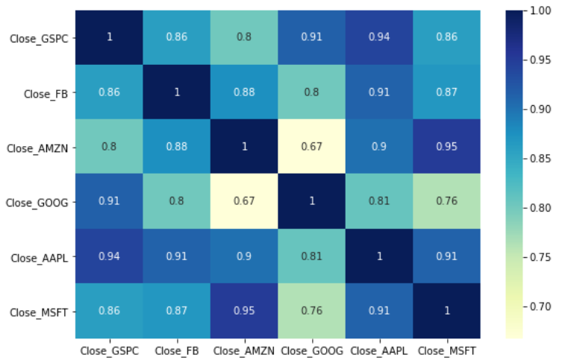
Exploratory Data Analysis
Correlation of variables:

Slide 8
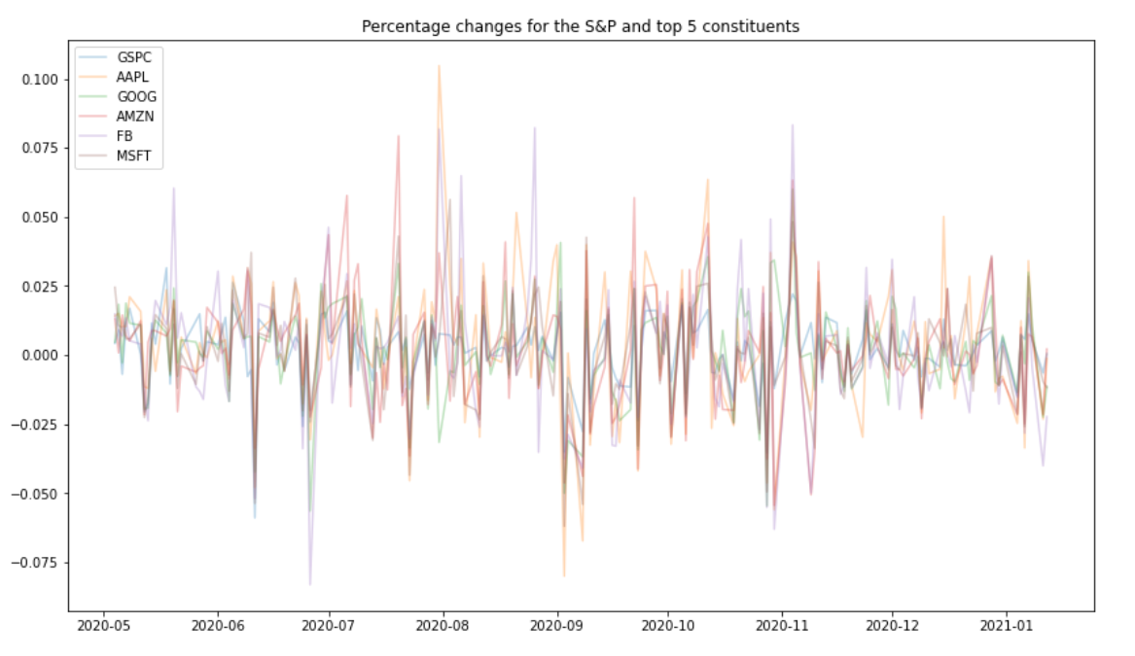
Exploratory Data Analysis
Daily Percentage Returns – note the mean around

Slide 9
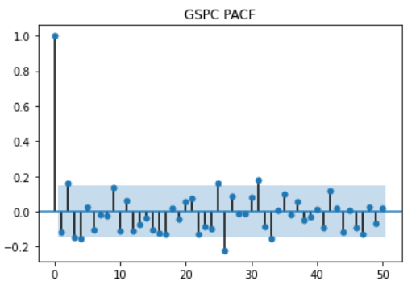
Exploratory Data Analysis
Partial Autocorrelation Plot – note the 1st note indicates the ideal model would be an AR(0)

Slide 10
Modeling
The machine learning methods chose were the following:
1) Auto Regressive Integrated Moving Average (ARIMA): in case the time series showed partial autocorrelations with lags and/or negative and positive partial autocorrelations
2) Vector Autoregression: to model variables that are cointegrated
3) Ridge (L2) Regression: to add an regularization term to my regression
4) Recursive Neural Network: to integrate both auto-regression and other exogenous variables

Slide 11
Analysis Results
The results from implementing each model were the following:
The best performing model was the recursive neural network.

Slide 12
Recommendation
My recommendation for future forecasts of the S&P would be to use a combination of the Ridge model along with the RNN given that the Ridge model provided more accurate results meanwhile the RNN provided a more dynamic estimate for the overall mean returns we could expect to see from the S&P.

Slide 13
Future Studies
If I were to perform future studies with the S&P I would probably try to forecast the S&P returns using an RNN with difference types of layers such as LSTM.
Additionally, I would like to perform a forecast using hourly prices as opposed to daily statistics to have a much more robust estimator with an adjustment for seasonality

